Slide 1
College 101
Ayde Flores
Elgin Community College District
Notes:
Hello everyone. My name is _______ _________ and I work for the Illinois Student Assistance Commission. Today, I am here to speak to you about higher education and some of your options after high school.

Slide 2
“Making college accessible and affordable for Illinois students.”
- Mission Statement
The Illinois Student Assistance Commission (ISAC) is the college access and financial aid agency in the state of Illinois that administers scholarship, grant, prepaid tuition, and student loan repayment/forgiveness programs.
Notes:
ISAC is the financial aid agency for the state of Illinois, which means we administer different grant, scholarship, and loan programs to help students pay for school. Our mission is to make college accessible and affordable for all Illinois students. Last year we administered nearly $400 million in grants and scholarships to Illinois students. Illinois has set a goal to increase the proportion of adults in Illinois with high-quality degrees and credentials to 60% by the year 2025

Slide 3
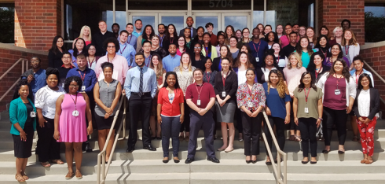
Illinois Student Assistance Corps
Approximately 80 Corps members from diverse backgrounds
Every community in Illinois
Changing the conversation about higher education
Notes:
I’m a part of the outreach department at ISAC in a program called the ISACorps. There are approximately 80 of us throughout the state, and we are working to help students get the resources they need to go to college. I work with schools in this area to get students information to help them answer the questions like, “What do I want to do after high school? Where do I go to do that? How do I pay for it?” I’m here to help you answer those questions about college, careers, and financial aid.

Slide 4
Overview
Here are some things we will talk about today……
Post-secondary options
Types of degrees and colleges
Apprenticeships
Military
Determining your “best fit” college(s)
Researching colleges
Notes:
Today we will talk about finding the right college for you based on your career interest and what is important to you in a college, going on college visits, and the different types of schools and degrees.

Slide 5
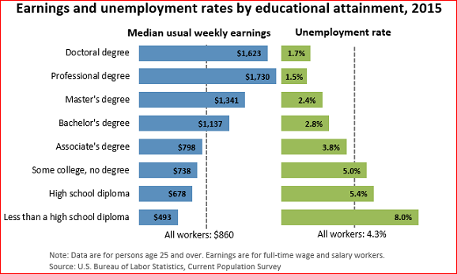
Average Earnings by Degree
Notes:
As show in this chart, individuals with more education have a better chance of being employed and earning more money than individuals with less education.
Source
http://www.bls.gov/emp/ep_chart_001.htm

Slide 6
Types of Degrees
Type | Approx. time
Certificate | 10-16 months
Associate’s | 2 years
Bachelor’s | 4 years
Master’s | 2 years (after a bachelor’s)
Professional | 3-6 years (after a bachelor’s)
Doctorate | 5-7 years (after a bachelor’s)
Notes:
Okay, so now that we know WHY it’s important, let’s take a look at the different types of post secondary options.
As you start to look at various degrees, there are many different types to consider. Depending on your long-term goals and the career you choose, you will want to select the one that is the best fit financially, socially, and academically.
A certificate program is a short-term program designed to give specific job training for vocational/ trade careers. They take anywhere from 10 – 16 months to complete
An associates degree generally takes 2 years and a bachelor’s degree generally takes 4 years. After you receive your bachelor’s degree, you can continue your education another 2 years for a master’s degree, 3 – 6 years for a professional degree, or 5 – 7 years for a doctorate’s degree.

Slide 7
Types of Colleges
Type | Degrees | Examples
Public Universities | Bachelor’s, Master’s, Professional, Doctorate | Northern Illinois
Private Colleges and Universities | Bachelor’s, Master’s, Professional, Doctorate | Bradley
Community Colleges | Certificate, Associate’s | Joliet Junior College
Trade/Vocational Schools | Certificate | UTI
Notes:
In addition to the types of degrees, you need to understand there are also different types of colleges.
There are 4 types of college – 4 year public, private universities, community colleges, and vocational schools.
Four-year public universities are probably the most obvious option that we generally think of. These tend to be relatively larger schools (20,000-30,000 students). We say they are public because they are affiliated with the state and receive some of their funding from taxpayer dollars. Some examples of state schools would be ISU, NIU, Eastern, etc.
Four-year private schools, on the other hand, tend to be smaller, although they can range anywhere in size from 1000 to 8000 students per campus. They are private because they are not affiliated with the state and do not receive money from the state government. Bradley University is an example of a private college.
Community colleges are a great option for students who want to stay close to home and have a little more time with their families. Many students choose community colleges for this reason. Additionally, tuition tends to be much more affordable at community college, and since most students have to take the same general education courses no matter where they start, these students take the same class but pay less. You can go to a community college to take your general requirements for the first 2 years and then transfer to a 4-year school, or you can go to a community college for your associate’s degree, which typically takes 2 years to complete. Some examples of a community college are Elgin Community College or Joliet Junior College
Vocational schools provide training for a specific job, often allowing students on-the-job experience. However, there is some overlap here with community colleges. For example, there are vocational schools out there for students who want to pursue careers in auto mechanics, cosmetology or construction, but many community colleges also offer programs or certification in those fields. So be sure to explore your options so you know what is best for you. UTI is a vocational school.
Vocational Schools also known as Trade Schools, Career Colleges, Vocational Training Programs; Non-profit VS. Proprietary School.

Slide 8
2015-16 Average Tuition and Fees
Public 2 year (in district) $3,347
Public 4 year (in state) $9,139
Public 4 year (out of state) $22,958
Private $31,231
For a specific Illinois school: http://www.isac.org/students/during-college/paying-for-college/college-costs.html
Notes:
Depending on the type of college you choose, the cost can vary significantly.
Note to Corps: Before you go over this slide, you can do the College Costs Activity. Refer to the College Costs Facilitator Guide.
The average cost of tuition and fees at a public 4 year (in state) university is approximately $9,139, while at private colleges it is an average of $31,231 and 2 year public $3,347.
Just remember that when a school quotes its’ “tuition and fees,” that number does not include things like room and board, books and supplies, and travel to and from school. So actually, these schools are more expensive than the numbers you see on the screen. But you should never let big numbers deter you from applying to a school if you are interested in attending – sometimes schools look expensive on paper, but end up being more affordable than you may think once you receive your financial aid award letters.
https://bigfuture.collegeboard.org/pay-for-college/college-costs/college-costs-faqs#

Slide 9
Deciding on a Major
Your interests
Debt you are willing to assume
Average salary
Job prospects
Notes:
There are also a number of majors that you can choose from.
Remember that completing college and getting a degree is all about your future. When deciding on a major, think about the likelihood of job employment in that field/career path and how much you are likely to earn. Also, consider how much you’re interested in a particular field. If you hate being in a chemistry lab, there’s no point in studying chemistry only to spend the majority of the rest of your life in a lab 40 hours/week.

Slide 10
Certificate Programs
Community Colleges
Certificate programs: Certified Nursing Assistant, Medical Billing and Coding, Welding, etc.
Assoc. Applied Science programs: Sonographer, Industrial Maintenance Tech., Dental Hygiene.
Vocational, trade, technical, and career colleges
Trade-specific schools
Apprenticeships: provided by employers or local unions
Notes:
So, now let’s talk take a closer look at each of the types of degrees. Let’s start first with certificate programs, who offers them, and what types of careers are available.
Certification programs can be available at community colleges, vocational, trade, technical, and career colleges or at trade-specific schools.
Community colleges often have associate’s and certificate programs for the same careers a trade or career college might offer. (Give example of one or two certificate programs at your local community college: Black Hawk College offers certificate programs such as Accounting Clerk Certificate, Agriculture Mechanics Certificate, and a Welding Certificate.)
When we talk about vocational training programs, trade schools, technical schools and career colleges, know that they are all essentially the same thing. These are schools that prepare students for a specific career, and there are a lot of options for a student looking to attend this kind of institution. Some examples of schools you may have heard of include DeVry University, ITT Tech, or Kaplan University all of which offer a variety of degrees and certificate programs.
Within these trade schools there are also trade-specific schools, which offer programs solely for a career in a very specific field. Examples of these would be Capri College or L’James International School which specialize in cosmetology, Morrison Institute of Technology (MTI) which focuses on engineering technology or Universal Technical Institute (UTI) which specializes in automotive technology.

Slide 11
Apprenticeships
Run by an employer or union
Teach skills for a specific trade
Combines on-the-job training and classroom instruction
Apprentice usually pays only for tools/supplies
Apprentice agrees to work for a minimum time after completing apprenticeship
Notes:
Apprenticeships are a specific career option as well. These are often run by either an employer or union group to give unskilled apprentices the skills necessary for employment in that field. Apprenticeships usually include a combination of on-the-job training with a skilled member of that community, and classroom instruction. Many times, the apprentice pays only for book/tools and supplies, and may receive a small amount of pay for the work they complete during their on-the-job training. In exchange, apprentices must usually agree to work for the employer or union for a minimum time frame upon completing the apprenticeship.

Slide 12
Popular Apprenticeship Programs
Electricians
Plumbers
Steel workers
Pipefitters
Boilermaker
Masons
Carpenters
Notes:
Here are some examples of popular apprenticeship programs.

Slide 13
Associate’s Degree Careers
Childcare worker
Dental hygienist
Mechanic
Paralegal
Physical therapist assistant
Nurse
Notes:
Another option is a regular college degree.
At the undergraduate level, you can obtain either an associate’s degree or a bachelor’s degree.
Here are some examples of some careers that are attainable with an associate’s degree. This list is by no means exhaustive. Remember, an associate’s generally takes 2 years to complete so long as you are passing all your classes and they all count towards graduation.

Slide 14
Bachelor’s Degree Careers
Accountant
Computer programmer
High School coach/teacher
Nurse
Journalist
Pilot
Notes:
And here are some examples of bachelor’s degree careers. Again, this list is not complete. You may notice that we have “nurse” on this slide again. That’s because you can get an associate’s in nursing or a bachelor’s in nursing. You can take your education even further and get a master’s in nursing. Can anyone guess why someone may study longer for a higher educational degree for their job? (Hopefully someone says they get paid more). The same applies to your teachers—they all definitely have a bachelor’s degree, but many of them probably have their master’s in education.

Slide 15
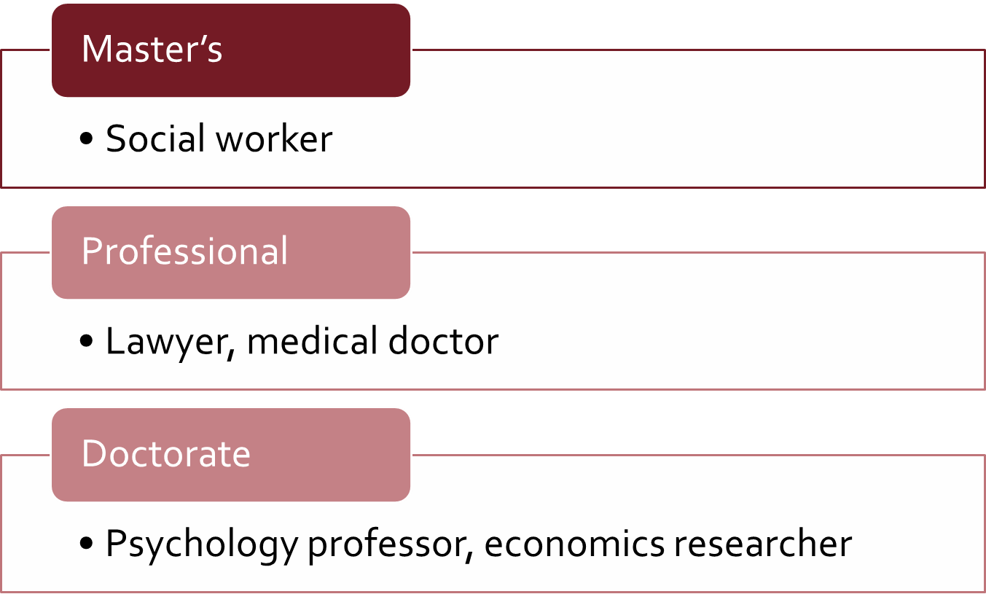
Post-Bachelor’s Examples
Notes:
Following your Bachelor’s degree, you can continue your education and pursue a Master’s, Professional, or Doctorate’s degree. Here are a couple of examples of different careers for each degree.

Slide 16
Military
Initial commitment is typically 4 years active duty and 2 years inactive
Branches include
Army
Navy
Air Force
Marine Corps
Coast Guard
National Guard
Long-term career vs. continued training/education
Notes:
Another option after high school is to join the military.
This is an opportunity to serve your country on a permanent or short-term basis. You can select from many branches – Army, Navy, Air Force, Marine Corps, Coast Guard, or National Guard.
Although many people decide to make this their permanent career, others may use it is an opportunity to obtain additional experience or education. The military offers tuition assistance to both the military member as well as their family.

Slide 17
Determining Your “Best Fit” College
Notes:
We like to talk about three sets of factors when determining your “best fit” college. Before we get into those details, let’s brainstorm what you think they might be.
[Note to Corps: Poll the audience and keep a list of what factors people think should be considered. The purpose of the activity is to help the audience activate their prior knowledge.]

Slide 18
Should You Pick a College Because…
Your boyfriend/girlfriend/best friend is going there.
You recognize its name.
They sent you a brochure in the mail.
Notes:
Note to Corps: What Do You Want In a College Activity may be done to supplement this slide. Please refer to the facilitator guide for more information. Be sure to go over the answers the students came up with and then explain the reasons to not choose a specific college. Transition from this slide to the next slide and show them what they should look for in a college. Do their lists match any of the features on the next slide? Are they forgetting any of these?
There are several reasons NOT to go to a school, such as (but not limited to) your girlfriend/boyfriend/best friend is going there, you recognize its name, or because they sent you a brochure. There are more important reasons to attend a particular institution than these.

Slide 19
Determining Your “Best Fit” College
academic
social
financial
Notes:
Again, we encourage students to consider three areas when they’re trying to determine their “best fit” college. It is important to get an idea of whether an institution will be a good fit for you academically, socially and financially. I’ll go through each of these areas and what you need to consider for each area.
What you want to do is find a school that matches your needs in all three of these areas. For example, if you can afford a school and the social experience is what you want, but you’re not getting what you need academically, you might graduate with a degree that’s not very helpful, or you might not graduate.

Slide 20
Academic: The basics
Available majors
Internship opportunities
Career/graduate school placement rates
Graduation and retention rates
Notes:
When looking into colleges and programs of study, remember that college is not just a 2 to 4-year deal. What you study and how you spend your time, whether in a 2-yr program at a community college or a 4-yr program at a university, will impact the kinds of opportunities you’ll have 20, even 40 years from now! The purpose of college is to give you the skill set you’ll need for a long time to come, if not for the rest of your life. Be sure to check out a school’s graduation rate and job placement rate for recent graduates.
Note to Corps: use College Navigator to identify graduation and retention rates for a couple of schools in their area or that they are potentially interested in.

Slide 21
Academic: Admissions
SAFETY
your academic record is stronger than most students
it’s basically guaranteed you’ll get in
MATCH
your academic record is similar to most students
you have a very good chance of getting in
REACH
most students have a better academic record than you
you have a chance of getting in
Plan on applying to at least two of each, for a total of six.
Notes:
You’ll want to apply to 1-2 reach schools, 1-2 good match schools and 1-2 safety schools. A school is a “reach” school if the middle 50% of students have higher GPA’s and ACT scores than you. These are schools you can maybe get into with very good recommendations, an excellent essay, and a one-on-one interview with an admissions representative. A school is a “good match” if you fall within the middle 50% of student GPA and ACT scores. A “safety” school is one where your GPA and ACT scores are in the top 25% of what admitted students had. These are schools you will most likely get into based on your grades and extra-curriculars. Make sure you like your safeties!! If you don’t get into any of your reach schools or a safety school offers you the best financial aid package, you might end up spending at least some of your college years there!

Slide 22
College Match Tool
https://isacportal.isac.org/en/collegematch
Notes:
ISAC offers a tool that can assist you in finding a good college match. Enter your ACT score and your grade point average (GPA) and you will get a list of colleges that match your qualifications. Make sure to investigate many different colleges to find your right fit. Don't limit your selection to only the colleges on this list.

Slide 23
Social
Religious affiliation
Extracurricular activities
Athletics
Theater/musical performances
Greek life
Average class size
Campus size
Commute vs. On-campus vs. Off-campus
Location
Notes:
We’ve already talked about some important factors when choosing a college. But there are other things that may be important. For example, do you want to be involved in intramural sports? Check and see if the school you’re looking at has this option. Remember to check out a bunch of schools. The more visits you make, the more you’ll learn about what’s important to you and what you want from your institution.

Slide 24
Financial
Cost of attendance
Expected family contribution
Financial need
Sticker price vs. Net price
Types of financial aid available
Gift (scholarships, grants)
Self-help (loans, work study)
Notes:
When choosing a college it’s important that you select one that works financially for you. Once you get further along in the application process, you will receive award letters from the schools you have expressed an interest in. You will want to make sure that you look at each offer carefully.
Because each college has its own packaging policy, the types of financial aid offered to you will probably vary from college to college. The FA offer may include a combination of financial aid programs from various sources, such as grants, scholarships, work-study and student loans. As you review your award letters, consider the cost of attendance, the EFC, your financial aid eligibility, the types of financial aid programs being offered, and your out-of-pocket cost.
Here are some of the questions that you may want to consider – what is the total cost of attendance at the school, how much will my family be expected to contribute, what type of aid is available, and what will I need to pay out of pocket?

Slide 25
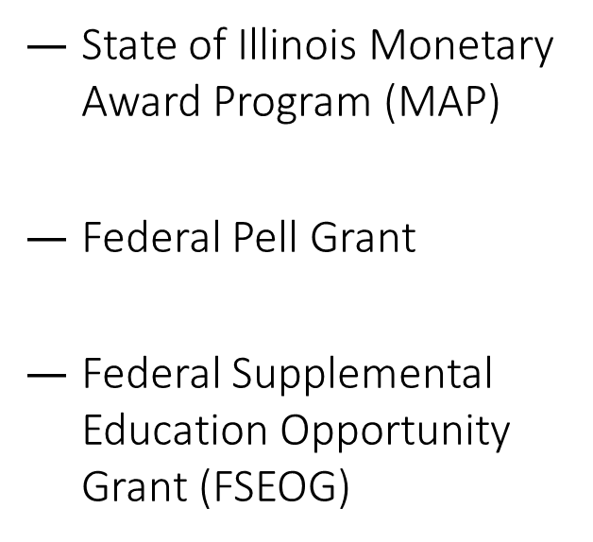
Financial
Maximum Award Amounts for 2017 - 2018
Total = $14,789
Notes:
As you start looking at colleges, the cost may seem a little overwhelming. Don’t forget, that there are plenty of sources of aid available. The Monetary Award Program, the Federal Pell Grant, and the Federal Supplemental Education Opportunity Grant are three of the largest grant programs for students in the state of Illinois. In order to find out if you are eligible, you need to complete the Free Application for Federal Student Aid (FAFSA). The FAFSA is required to determine a student’s eligibility for federal and state grants as well as student loans, and other types of aid that are administered by the college or university. By completing a FAFSA, students are considered and may qualify for some or all of the following need-based grants: Pell, FSEOG, and MAP.

Slide 26
Picking a College is A Lot Like Dating
Do you want to be with this college for possibly the next 4 years?
Does the college match your wants?
Does the college better prepare you for your future?
Do you and the college have the same values?
Does the college just look good online?
Are you going to this college just because your friends want you to?
Notes:
*College Dating Activity may be done in place of this slide. Please see facilitator guide and document for more information.
Choosing a college can be similar to dating! Would you want to see a potential boyfriend/girlfriend online and promise to date them for the next four years without going on a date first? No WAY! That’s why it is important to go on a college visit. You should “date” your college before making the big decision on “living with” it!
Would you date someone who makes you feel miserable because you can’t be yourself around him/her? No way! That’s why it is important that you find a college that matches your wants in a institution of higher education. We just talked about the important things to think about when finding the right fit.
The college you choose should better your future, and prepare you for the person you want to be 5, 10, 50 years from now! Would you date someone who held beliefs completely different than you? Maybe, maybe not. It depends on you! That is why it is important that you know what you are comfortable with so you know what kind of “atmosphere” you would like at a college.
Would it make sense for a college to take a horrible photo of itself and then show everyone? OF COURSE NOT! A college’s website, brochures, etc. are SUPPOSED to make a person inclined to attend. This is another reason it is important to go visit the college first! Let’s talk about why it is important to visit a college (go to next slide).

Slide 27
How to Find Colleges
Studentportal.isac.org
ISAC’s College Match tool
College Scorecard
Ask teachers, counselors, and other adults
Choose 3-4 schools you’ve never heard of to research.
Don’t rule out any schools based on cost.
And remember, aim to apply to at least 2 safety, 2 match, and 2 reach schools
Notes:
There are 1000s of colleges in the United States. How do you find a handful that might be right for you? Remember to spend time researching schools that offer programs you’re interested in. There’s no point looking at an art school if you want to study biology. Also, never decide what is affordable until after you’ve received a school’s financial aid offer. Use the tools on studentportal.isac.org to research schools.
“Don’t rule out a school based on cost” - Know that there are fee-waivers available!!! Most schools will have application fee waivers for low-income students. Talk to your guidance counselor or contact the school itself to ask about obtaining a fee waiver.
Resource: NACAC Application Waiver: http://www.nacacnet.org/studentinfo/feewaiver/Pages/default.aspx
Resource: Collegeboard Application Fee Waivers: https://bigfuture.collegeboard.org/get-in/applying-101/college-application-fee-waivers

Slide 28
College Visits
It is going to be your home for the next 4 years.
Every school looks good on a brochure or website.
Get a sense of the on-campus experience.
Notes:
Campus visits will give you a better idea of whether you can see yourself as a student at a particular school. Every school looks good in a brochure, so it’s important to actually put yourself on that campus.

Slide 29
College Visits: Be Proactive
Ask intelligent, prepared questions.
Schedule a one-on-one appointment with an admissions representative.
Talk to students who attend that school.
Consider an overnight stay.
Attend a class.
Notes:
When on a college visit, ask questions, but be sure they are intelligent! Schedule a one-on-one appointment with an admissions representative. Students who do this are more likely to get admitted. Ask current students questions to see how they feel about attending that institution—they will generally give you their honest feedback. Consider an overnight stay with a current student. Many schools offer this opportunity so that prospective students can get an idea of what it is like to attend their institution. Attend a class to get a feel for what the academic pace is.

Slide 30
Your Support Network
Involve others in your decision-making process
Ask questions!
Notes:
When you have narrowed down your search, talk to your family or someone else whose opinions you value. Think about what you want in a college and ask questions! You can ask a parent, an older brother/sister/cousin/relative, a counselor, and/or a teacher. Remember that finding the “right fit” school is a multi-faceted decision.
If you’re among those who are applying to college as a first-generation student (meaning your parents never attended college) and you’re hesitant to talk about your parents’ educational attainment, you’re not alone. Thirty percent of entering freshmen in the United States are first-generation college students.
Source: http://thechoice.blogs.nytimes.com/2013/02/11/tips-for-first-generation-college-applicants/
#1.) First-Gen Tip: Complete Optional Application Sections - The additional information section on the Common Application is an ideal place for you to write an essay that highlights how your life has been shaped by having parents who did not attend college. It is also an opportunity to demonstrate what attending college means to you, given your background. By opting out of this section, you lose a chance to set yourself apart from your peers.
#2.) First-Gen Tip: Look for Resources at Your School - Statistics show that first-generation students often need more support. Nationally, 89 percent of low-income first-generation students leave college within six years without a degree. More than a quarter leave after their first year — four times the dropout rate of higher-income second-generation students. Unfortunately, many first-generation college applicants don’t have parental support to help guide them through the application process. Seek help by contacting the admissions office at your prospective colleges to ask if they have programs, guides or other resources for first-generation students.

Slide 31
Free Online Resources
Notes:
So, now we are going to talk about a couple of on-line resources – College Scorecard and the ISAC Student Portal

Slide 32
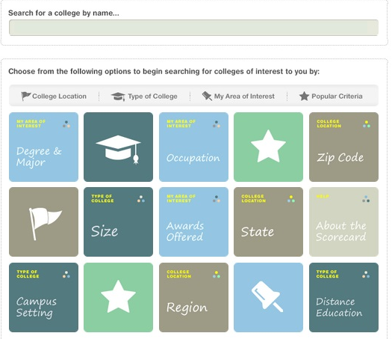
College Scorecard
Search for colleges by…
Programs or Majors
Location
Enrollment size
whitehouse.gov/issues/education/higher-education/college-score-card
Notes:
Try out the new College Scorecard at http://www.whitehouse.gov/issues/education/higher-education/college-score-card!
You can use the College Scorecard to find out more about a college’s affordability and value so you can make more informed decisions about which college to attend. To start, enter the name of a college of interest to you or select factors that are important in your college search. You can find scorecards for colleges based on factors such as programs or majors offered, location, and enrollment size.

Slide 33
studentportal.isac.org
Notes:
The student portal is a free resource that was created to assist high school students in mapping out their post-secondary plans. Use the ISAC Student Portal to help you choose a college, learn about careers, find scholarships, simplify the financial aid process, learn how to budget your money, and much more.

Slide 34
Review
Types of colleges and degrees
Identify your interests and goals
Determine “best fit” college(s) based on academic, social, and financial factors
Find your support network
Ask Questions!

Slide 35
Resources
www.studentportal.isac.org
www.isac.org
www.StudentAid.gov
Notes:
At ISAC, we are committed to making college accessible and affordable for all Illinois students. As you plan for, apply to, and pay for college, take advantage of the information and interactive tools that are available – at no cost – using these resources and websites.

Slide 36
Contact Information
Ayde Flores
ISAC Rep—Elgin District
Ayde.Flores@isac.illinois.gov
(224)762-3558
Notes:
Here is my contact information. If you have any questions about scholarships, or any part of the college going process, please do not hesitate to contact me. I also have business cards available.

